Slide 1
Mobility through Union action
Charles-Etienne Jamme
SETCA delegate at SWIFT
Notes:
SWIFT Training
Our knowledge, your solution.
www.swift.com/training

Slide 2
At the beginning there was …
Personal motivation factor
Bicycle
Environmental consciousness
The global view : all transport modes
You shouldn’t pay more than your time to commute to work
Convincing others
Leading by example
Spreading the word to the “Corporate Authorities”

Slide 3
The confrontation time Part I : towards radicalisation
NO WAY from HR
Promises from other unions
Call for action
Communicate, Communicate, Communicate
Flyers
Internal Newsgroups
Path of No Return : 2008
Enlisting on a Union for the social elections

Slide 4
The confrontation time Part II : finding allies
Elections results
only representative elected from SETCA
high personal score
Other Unions greetings
Huge support from some members (CNE – Peter Billington)
Push back from others
Repetitive topic at the Agenda of both Health and Safety committee (CPPT) and Work Council (CE)
CSR team is your friend

Slide 5
The confrontation time Part III : finding information
Who else is active in Mobility?
GRACQ & ProVelo
RISE
Greenpeace
Newspapers
What has been achieved in other corporates?
DEXIA CCT (Collective Bargain Agreement) : the reference
Colruyt mobility example
Consolidation in a mobility plan

Slide 6
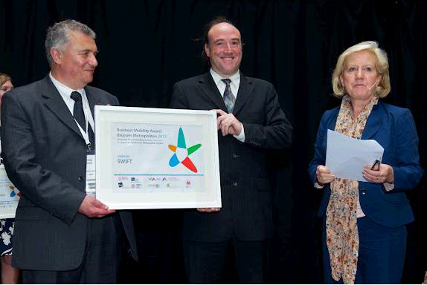
After 4 years of implementation SWIFT Mobility Offering
Public transports
Private shuttles
Bicycles
Carpooling
Flexible car policy
Flexible work time
Work from home
In 2012 SWIFT received the Business Mobility Award

Slide 7
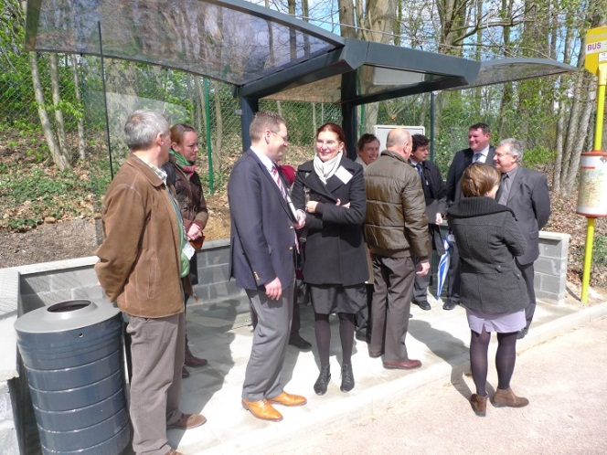
SWIFT Mobility Offering Public Transports
Free Train subscription
Combined with STIB/MIVB
Free Bus subscription (TEC/De Lijn)
SWIFT shuttle buses
La Hulpe train station (Ottignies)
Direct from/to Brussels
SWIFT bus shelter

Slide 8
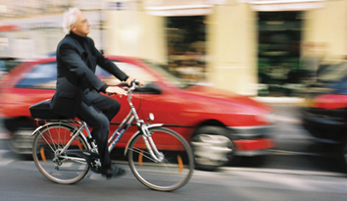
SWIFT Mobility Offering Bicycles
Facilities
Showers, changing rooms, lockers
Bicycle parking places close to building entrances
Bike to Work intervention : 0,21 €/km
Bicycle repair stations
Electric bicycles
Bicycle reflective jackets

Slide 9
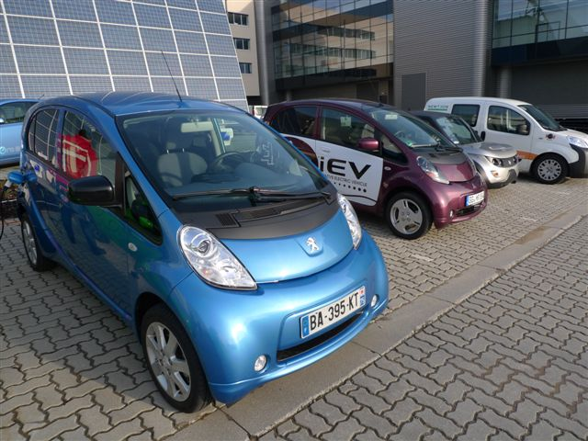
SWIFT Mobility Offering Cars
Flexible car policy
Opt Out for Level 60 and above
Mobility budget
Bicycles
Motorbike
Tablet
Railease
Carpooling
Carpool Plaza subscription (2010)
Carpool parking places
Web 2.0 technologies (2013)

Slide 10
First we need to decide what needs to be done Then we’ll do it And then we’ll ask if it was possible. Paul Hawken, 2009

