Slide 1

Training, an essential condition for access to the labour market, quality jobs for younger people and maintenance and progress of work for older people
ETUC Conference 05 October 2012
Loukas Zahilas, Cedefop, Senior Expert
Notes:
1

Slide 2

Europe in the time of crisis
The route to lasting economic recovery and social cohesion passes through knowledge, skills and competences. Only on this basis can we encourage the intensified innovation and entrepreneurship needed in the coming years.
Europe and the European countries need world class VET.
Loukas Zahilas
2

Slide 3

Europe 2020 – VET challenges
As rapid change threatens to outpace the skills of an ageing workforce and Europe developed towards a knowledge based society, the European Union (EU) and other European countries and the social partners have worked together to establish a policy framework for modernising education and training that led to the development of the European tools and principles.
Loukas Zahilas
3

Slide 4
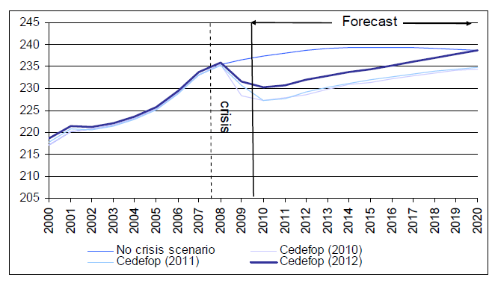
Past and future employment prospects
Between 2008 and 2010 Europe lost around 5.5 million jobs due to the economic slowdown.
Cedefop’s latest 2010-20 forecast assumes that problems in the
Eurozone will not lead to another crisis and that a modest recovery will bring job growth in all MS.
The forecast is that there
will be some 8 million newly created jobs.
Labour force by qualification 2000-20 (millions) Source: Cedefop, 2012
Loukas Zahilas
4

Slide 5
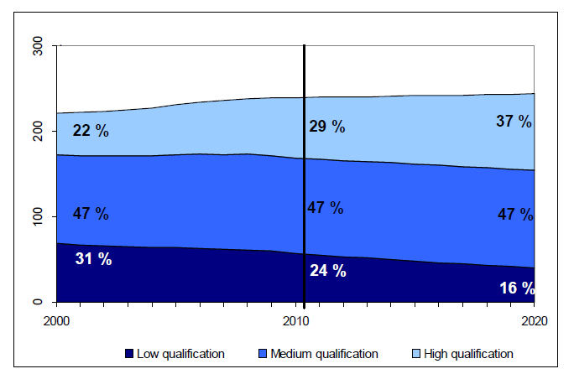
Levels of qualifications rising
Overall in Europe, numbers of people with
medium- and high-level qualifications will continue to rise as, generally, young people will have higher qualifications than the older workers who retire.
Labour force by qualification 2000-20 (millions) Source: Cedefop, 2012
Loukas Zahilas
5

Slide 6


Need for responses
By implementing the European tools and principles the Member States respond directly to the future LLL challenges.
As they promote using learning outcomes systematically, the European and national qualifications frameworks offer a common reference point for European and national cooperation which aims at reforming VET and lifelong learning.
6
Loukas Zahilas
6

Slide 7
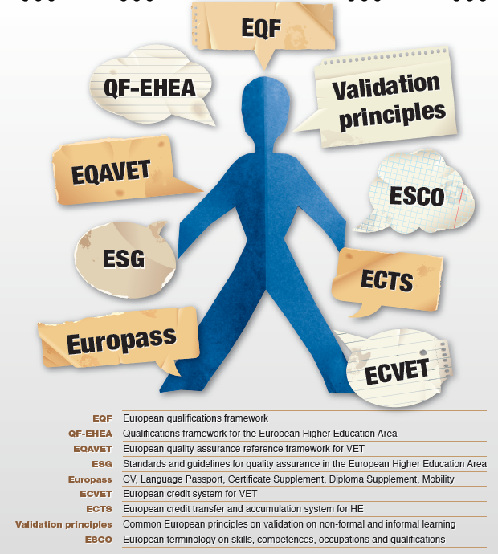
The common EU tools
Loukas Zahilas
7

Slide 8
Need for a common language
Loukas Zahilas
8

Slide 9

EQF/NQFs
The EQF supports lifelong learning and mobility by being common reference framework for qualifications. It has eight levels which enables national qualifications (general and higher education and vocational education and training) to be
compared with each other and those of other countries.
Setting up the EQF has triggered development of national qualifications frameworks (NQFs) in many European countries that see them as the best way to link national qualifications to the EQF.
Loukas Zahilas

Slide 10
Country A
Country B
EQF Level 8
Q
NQF/
NQS
EQF Level 7
NQF/ NQS
Q
EQF Level 6
Q
NQF/
NQS
EQF Level 5
NQF/ NQS
Q
Q
NQF/
NQS
EQF Level 4
EQF Level 3
Q
NQF/
NQS
NQF/ NQS
Q
EQF Level 2
Loukas Zahilas
EQF Level 1
10

Slide 11
NQFs development: a dynamic process
11

Slide 12
EQF and NQFs
EQF has acted as a catalyst for NQF developments in Europe.
The importance and priority attributed to NQFs across Europe is confirmed;
All countries are developing/introducing an NQF;
A clear trend towards comprehensive NQFs covering all levels and types of qualifications;
The ambitions and degree of integration/coherence vary between countries;
The degree of involvement of stakeholders varies between countries – an important indicator for the future impact of the frameworks.
Cedefop overviews NQF developments in: 27 EU member states, 2 EEA countries (IS, NO), 2 candidate countries (HR, TR) and covers a total of 34 frameworks (2 in Belgium, 3 in the UK)
12
Loukas Zahilas
12

Slide 13


EQF is becoming reality
The EQF has made important progress over the past years;
All EU, EEA and candidate countries implement the voluntary tool
15 EU Member States have already linked their NQFs to the EQF
Remaining countries will follow in 2012 and 2013
Introducing the reference to EQF levels in new individual certificates and diplomas starting from 2012
Loukas Zahilas
13

Slide 14

Challenges ahead
  Need to carefully balance the need for system-wide approaches (overall permeability) with the implementation within subsystems (VET, higher education) and their specific needs
  To further strengthen learning outcomes based approaches – implementation is uneven and sometimes slow
  How to further develop quality assurance relevant to learning outcomes based frameworks?
  The visibility of the NQFs to end-users, individuals and employers need to be given priority and is crucial for ownership and trust!
Loukas Zahilas
14

Slide 15

EQF must be set up as a trade mark
To be done urgently:
complete referencing process to the EQF
introduce reference to EQF levels in individual certificates and diploma
Loukas Zahilas
15

Slide 16
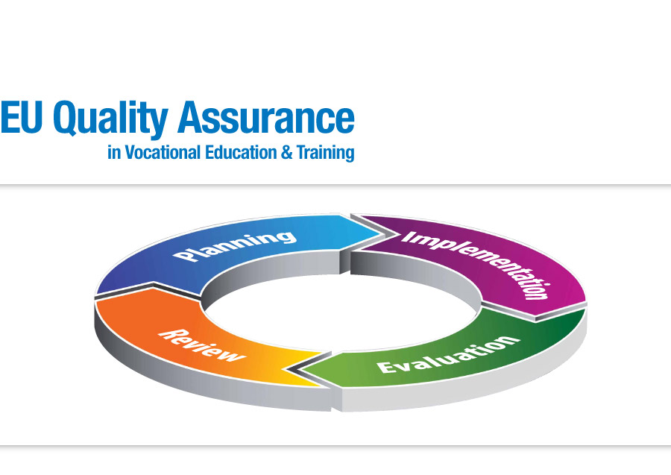
EQARF
EQAVET aims to increase the transparency, market relevance, consistency and transferability of vocational education and training qualifications across Europe. EQAVET is compatible with the main quality models. It includes a quality assurance and improvement cycle based on quality criteria and indicative descriptors. It addresses both VET systems and VET providers.
Loukas Zahilas

Slide 17

EQF and EQAVET
The EQF and EQAVET operate at the systemic level. Most countries by linking their national qualifications systems to the EQF make easier recognition of qualifications across Europe. By supporting quality assurance, EQAVET provides a basis for confidence and trust in national VET qualifications and their international comparison
Loukas Zahilas

Slide 18

ECVET
ECVET promotes geographical and professional mobility. It helps validate, recognise and accumulate work-related skills and knowledge acquired during a stay in another country or in different situations, so that these experiences contribute to vocational qualifications.
Loukas Zahilas

Slide 19

1
Host
provider
Sending
provider
Learning agreement
The individual
acquires
KSC
Learning outcomes
are recognised and
accumulated as a part of the
aimed qualification;
corresponding ECVET points
are included.
7
ECVET
3
2
The learning outcomes are assessed
Credit is validated
6
Credit is awarded to the individual for the learning outcomes achieved
4
Learner's credit
in an individual
transcript of record
5
Loukas Zahilas
Notes:
19

Slide 20

Europass
An initiative of the European Union to
make knowledge, skills and qualifications more visible and legible
Help European citizens move
Build bridge between national education and training systems
Loukas Zahilas
20

Slide 21
Europass: Five documents
Two documents in free access: the Europass CV and Language passport
completed online in 26 languages, room for non formal and informal learning, updated online
Three documents issued by national authorities:
Europass Mobility
a record of any period of time spent in another European country (work placement in a company, an academic term, a voluntary placement in an NGO); detailed description of skills acquired and facilitates their validation
Europass certificate supplement (vocational education and training)
gives a detailed description of vocational qualifications
Diploma Supplement (higher education)
gives a individualised description of topics studied, marks obtained
issued by the higher education institution awarding the original degree
Loukas Zahilas
21

Slide 22
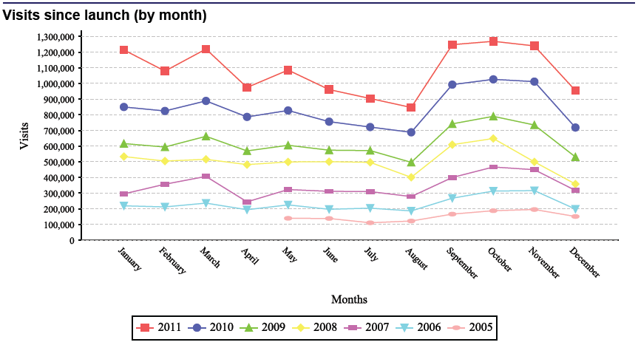
Europass: A success story
13.0 million visits in 2011 (as against 10 million in 2010 and a total of 44.8 million visits since its launch
9.9 million documents downloaded in 2011 and a total of 37.2 million downloads since its launch
5.9 million documents generated online in 2011 5. 8 million CVs and 79,000 Language Passports and a total of 16.9 million documents generated online since its launch.
Loukas Zahilas
22

Slide 23

Lifelong guidance and counselling
The Council of the European Union has adopted two guidance resolutions one in 2004 and another in 2008. An important goal for lifelong guidance is to promote equality of access to, participation in, and outcomes of lifelong learning, as well as labour market participation.
Loukas Zahilas

Slide 24

Validating non-formal and informal learning
In 2004 the European council adopted the European principles on validation. These were complemented by the 2009 by the European guidelines for validating non-formal and informal learning. The European Commission has already presented (5 September 2012) a European Recommendation on validation of non formal and informal learning.
Loukas Zahilas

Slide 25


Reforming VET provision
Getting the right people to become VET teachers
Developing them into effective learning facilitators
Teachers and trainers are the pillar of any VET reform.
Loukas Zahilas
25

Slide 26

Coherence, integration, and coordination
To ensure that European tools and principles interact effectively, their development and implementation must be coherent.
This may require an integration of existing tools, defining and clarifying the role that each plays in relation to the others and using a common terminology facilitating cross-references.
There is a need to bridge the gap between the concepts and their application to the realities of national education and training and qualifications systems.
Making the most of the European tools and principles requires openness, dialogue, patience and determination.
Loukas Zahilas
26

Slide 27

2012 - European Year for Active Ageing and Solidarity between Generations
Three areas:
Employment – as life expectancy increases we must give older workers better chances in the labour market.
Participation in society – retiring from one's job does not mean becoming idle. The European Year seeks to ensure greater recognition of what older people bring to society and create more supportive conditions for them.
Independent living – our health declines as we grow old, but a lot can be done to cope with this decline.
Loukas Zahilas
27

Slide 28

Active Ageing
Active ageing means growing old in good health and as a full member of society, feeling more fulfilled in our jobs, more independent in our daily lives and more involved as citizens.
No matter how old we are, we can still play our part in society and enjoy a better quality of life. The challenge is to make the most of the enormous potential that we harbour even at a more advanced age.
Loukas Zahilas

Slide 29
Training ageing people – 7 principles
I was surprised how helpful I found the interview…. and it has certainly spiked my interest in returning to learning
Motivation - make entry easy and deal with initial fear
Structure - base training on work tasks
3. Familiarity - build on existing skills
4. Organisation - change manager and supervisor attitudes
5. Time - allow adequate time
6. Active participation - avoid the standard training setting
7. Learning strategies - take account of learning method
UK, 40+
employed
Half of employers expect recruiting
problems in the future, but only 15%
adapt their training to ageing workers
Working and ageing, Cedefop 2012
Loukas Zahilas

Slide 30




Cedefop’s work
Λουκάς Ζαχείλας, Cedefop

Slide 31



European tools and principles
Labour market,
Further studies
Career development
Certification
for further
qualification
Validation of
learning
outcomes
Further work
experience
and learning
Formal learning
programme
Guidance
Qualifications,
credits,
work experience
Loukas Zahilas
31

Slide 32

Cedefop
Cedefop
Thanks for your attention
www.cedefop.europa.eu
Loukas Zahilas
Notes:
32

