Slide 1

ETUC Youth Committee Meeting
8-9 December 2025
The ETUC has zero tolerance for any violence and any type of harassment including sexual harassment.
The ETUC Code of Conduct for Meetings, Events and Courses sets out policy and procedure to ensure that our working environments are free from violence, harassment and sexual harassment.
The document is available in English, French, German, Italian, Spanish and Polish.

Slide 2



Traineeship – The Last Lap

Slide 3

Four column document
EC Proposal
April 2024
EP Opinion
October 2025
General Approach
June 2025
Trialogues (compromise)
November =>

Slide 4
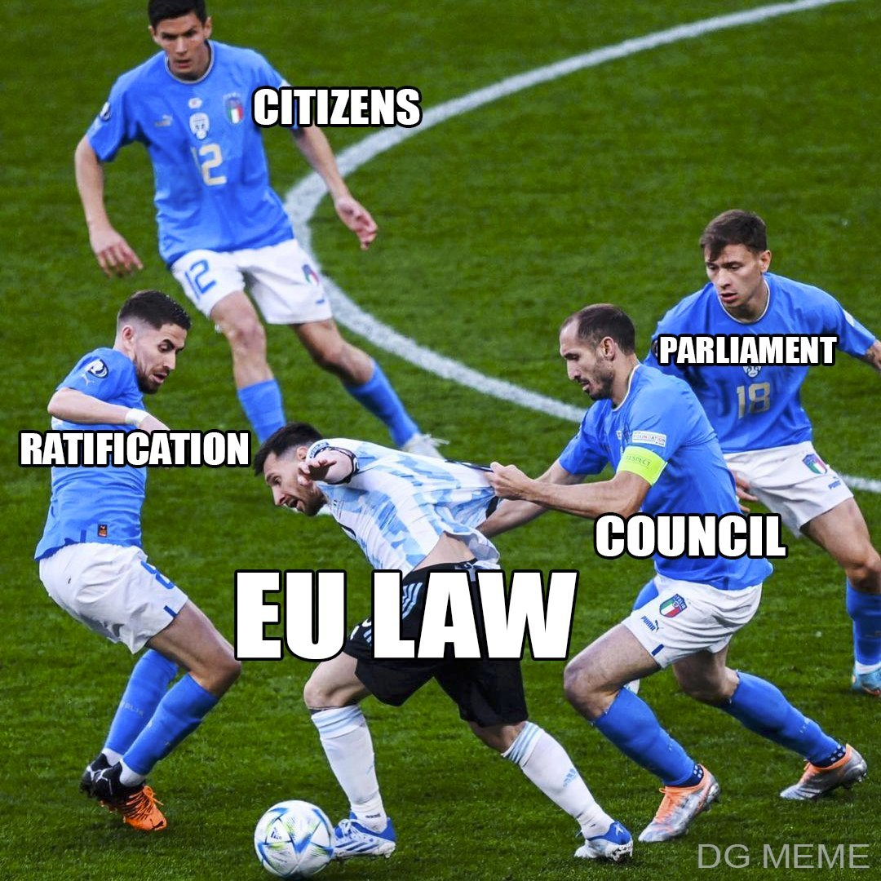
Trialogue?

Slide 5
EP Opinion:
Closest to the ETUC Position
Rapporteur very supportive (Alicia Homs S&D)
Support from Renew /EPP lacking
ECR & Patriots are completely against

Slide 6
EP Opinion:
Article 1 | Subject Matter & Scope
Article 2 | Definitions
Article 3 | Traineeship Agreement & Decent Working Conditions
Article 4 | Measures to detect and combat practices that circumvent the purpose of traineeships and the use of standard employment relationships disguised as traineeships
Article 5 | Assessment of practices that circumvent the purpose of traineeships and the use of standard employment relationships disguised as traineeships
Article 6 | Implementation and enforcement of relevant Union law
Article 7 | Dispute resolution and right to redress
Article 8 | Procedures on behalf or in support of trainees
Article 9 | Protection against adverse treatment and consequences and burden of proof
Article 10 | Penalties
Article 11 | Non-regression and more favourable provisions
Article 12 | Transposition and implementation

Slide 7
EP Opinion:
Article 1 | Subject Matter & Scope | GROUP 1
Article 2 | Definitions
Article 3 | Traineeship Agreement & Decent Working Conditions
Article 4 | Measures to detect and combat practices that circumvent the purpose of traineeships and the use of standard employment relationships disguised as traineeships | GROUP 2
Article 5 | Assessment of practices that circumvent the purpose of traineeships and the use of standard employment relationships disguised as traineeships
Article 6 | Implementation and enforcement of relevant Union law | GROUP 3
Article 7 | Dispute resolution and right to redress
Article 8 | Procedures on behalf or in support of trainees | GROUP 4
Article 9 | Protection against adverse treatment and consequences and burden of proof
Article 10 | Penalties | GROUP 5
Article 11 | Non-regression and more favourable provisions
Article 12 | Transposition and implementation

Slide 8
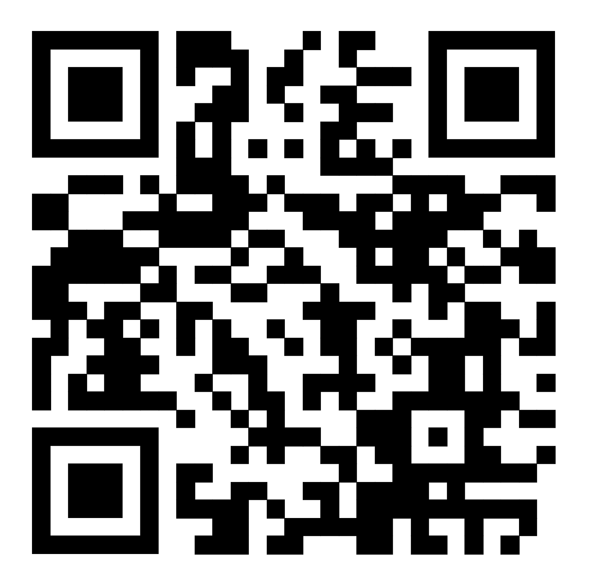
EP Opinion

Slide 9
Group Task :
Report on the main elements
Asses the main added value compared to reality
Decide one element we should not lose in the negotiations (red line)

Slide 10
ETUC Youth Committee Meeting
8-9 December 2025
The ETUC has zero tolerance for any violence and any type of harassment including sexual harassment.
The ETUC Code of Conduct for Meetings, Events and Courses sets out policy and procedure to ensure that our working environments are free from violence, harassment and sexual harassment.
The document is available in English, French, German, Italian, Spanish and Polish. Please find the link in the chat.

Slide 11
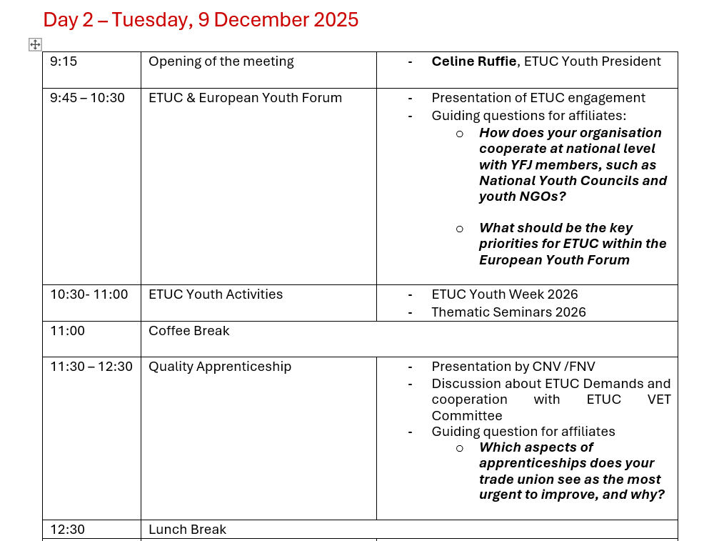

Slide 12
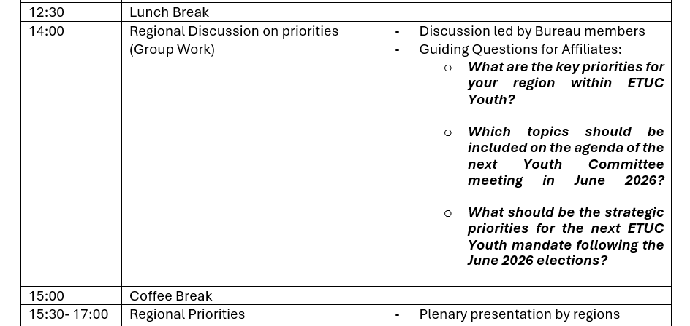

Slide 13
ETUC & EUROPEAN YOUTH FORUM (YFJ) => Vera De Man (NL) => Mathis Godefroid (LU)

Slide 14
ETUC & EUROPEAN YOUTH FORUM (YFJ) How does your organisation cooperate at national level with YFJ members, such as National Youth Councils and youth NGOs? What should be the key priorities for ETUC within the European Youth Forum?

Slide 15
Upcoming Activities 2026

Slide 16
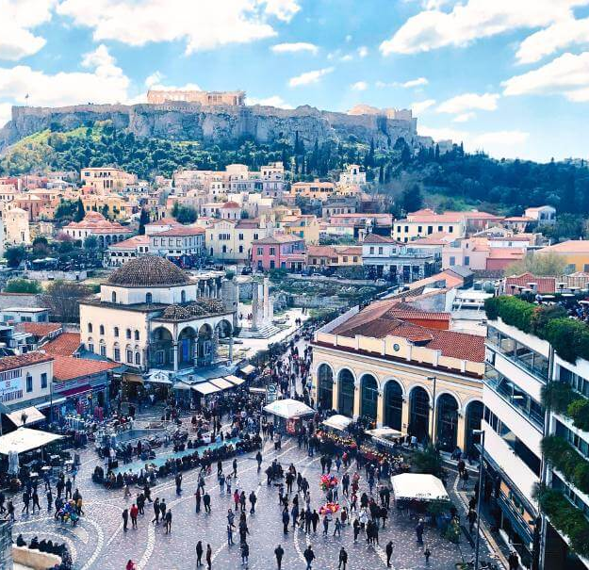
Youth Training Week
Gamification
Athens, 26/30 January 2025
Deadline to register 6th January
Two webinars 16 & 23 January

Slide 17

Working Time Reduction
Brussles, 19/20 February 2026
1 person/Organisation
Youth Voice project

Slide 18

23-25 March 2026
Youth 4 Future
Twin Transitions
Torino, 23/25 March 2026
(priority to participants of the previous seminars)

Slide 19
Quality apprenticeships => Finja Lee-Bethke

Slide 20
Quality Apprenticeships Which aspects of apprenticeships does your trade union see as the most urgent to improve, and why?

Slide 21

ETUC Youth Committee
Lunch Break
The meeting will start again at 14:00

Slide 22
Regional Priorities

Slide 23

ETUC Youth Bureau
Celine Ruffié (ETF)
Finja Lee Bethke, (DGB Germany) Vera De Man, (CNV The Netherland)
Raquel Antunes Tremoco, (UGT Portugal)
Mathis Godefroid, (LCGB Luxembourg)
Alicja Skowron, (Solidarnosc, Poland)
Ástþór Jón Ragnheiðarson, (ASI Iceland) Antonella Kardum, (SSSH Croatia)

Slide 24
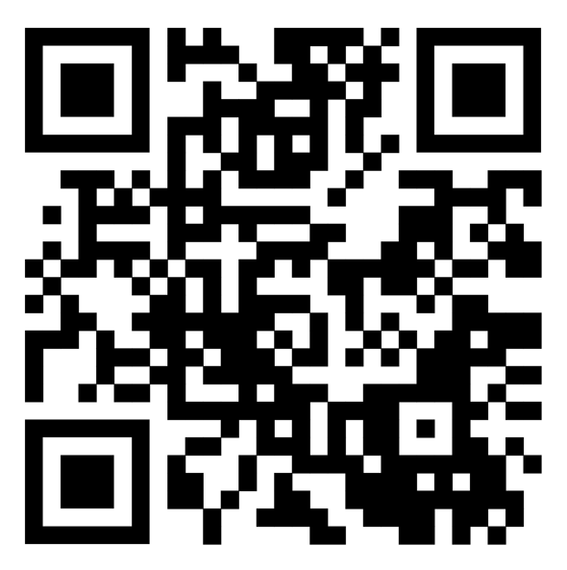
ETUC Youth Bureau - Elections
17 June - 2026 (deadline for applications: 1 May 2026)
Rules and procedures- ETUC Youth

Slide 25
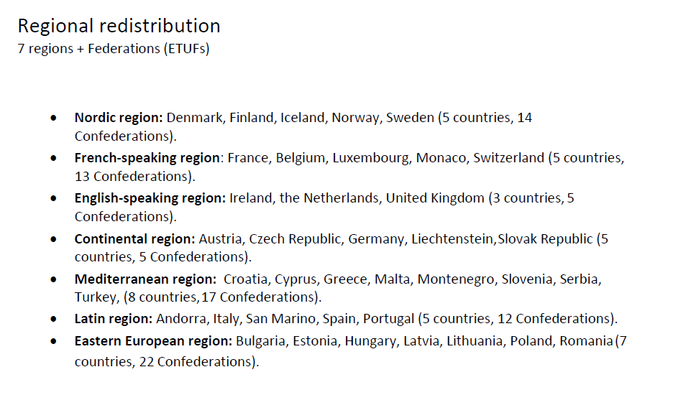
ETUC Youth Regions

Slide 26
Regional Priorities What are the key priorities for your region within ETUC Youth? Which topics should be included on the agenda of the next Youth Committee meeting in June 2026? What should be the strategic priorities for the next ETUC Youth mandate following the June 2026 elections?

